Slide 1

2023

Slide 2
Data Science and AI
Module 1
Part 2:
Python for Data Science

Slide 3
Agenda: Module 1 Part 2
Python Fundamentals
Software Engineering Best Practices
Using Git & GitHub for Version Control

Slide 4
Python versions: 2.7 vs 3.x
version 2.x
large code base
last version = 2.7 (no more releases!)
version 3.x
print is a function
raising & catching exceptions
integer division (2.x truncates; 3.x converts to float)
short → long integers
octal constants: 0nnn → 0onnn
unicode strings
…

Slide 5
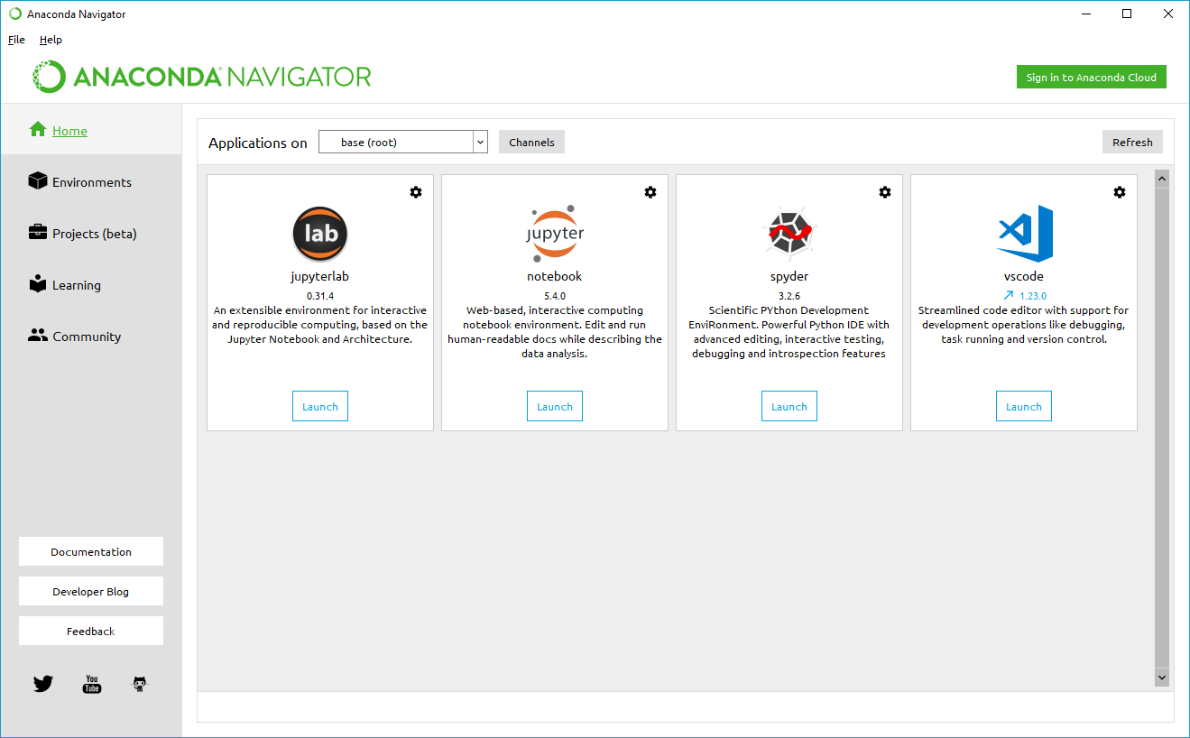
Developing and running Python
Jupyter notebook
Visual Studio Code (VSC)
VSC now has built-in Jupyter notebook support
Jupyter Lab
Command prompt
Anaconda
Anaconda distribution is the recommended way to configure and manage your Python development and running environment(s).

Slide 6
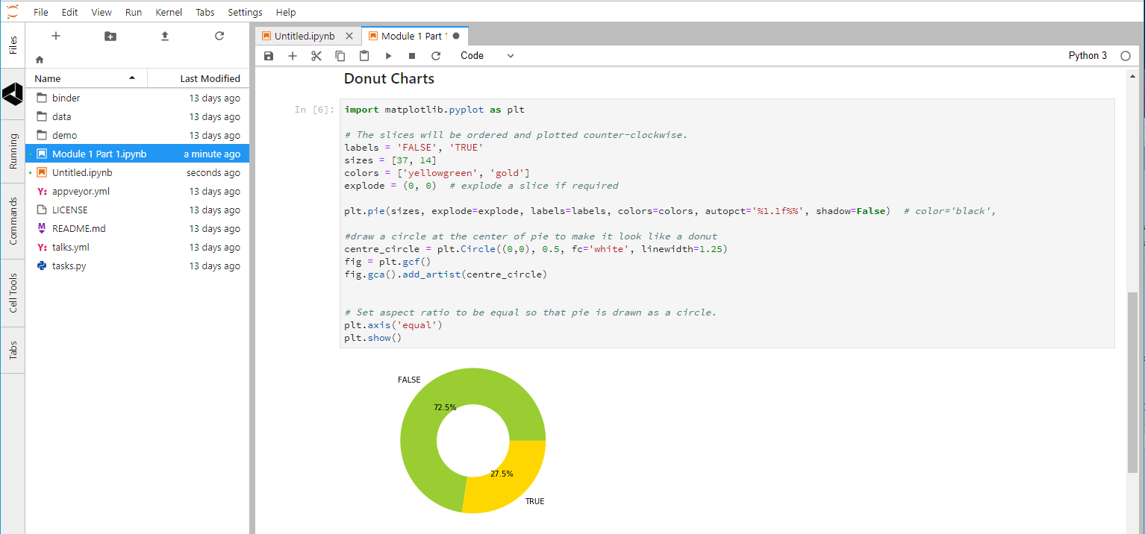
Jupyter Notebooks
shareable
environment-based
interactive or batch execution
> 40 languages
Python, R, Scala, …
Big Data support
Spark

Slide 7
Generic Data Types
Numeric | Text | Other
integer signed, unsigned | character unicode | Boolean true, false Binary 2^{n}
floating-point (‘float’) double = 2 x float | string character array 0-based or 1-based null-terminated or length-encoded usually immutable in OOP | unassigned null NA undefined NA +, − infinity
complex 2 x double (real, imaginary) | document key-value pairs (JSON strings) | BLOB images, video signals

Slide 8
Classes
2 underscores before/after init
the self parameter is not explicitly mapped to the function call
class phasor:
def __init__(self, r=0, p=0):
self.r = r
self.p = p
def real(self):
return (self.r * math.cos(self.p))
def imag(self):
return (self.r * math.sin(self.p))
z = phasor(2.7, 0.4 * math.pi)

Slide 9
Pandas
high-performance, easy-to-use data structures and data analysis tools
DataFrame class
IO tools
data alignment
handling of missing data
manipulating data sets
reshaping, pivoting
slicing, dicing, subsetting
merging, joining
import pandas as pd
https://pandas.pydata.org/

Slide 10
Scikit-learn
biggest library of ML functions for Python
classification
regression
clustering
dimensional reduction
model selection & tuning
preprocessing
$ pip install -U scikit-learn
or
$ conda install scikit-learn
http://scikit-learn.org/stable/

Slide 11
Other Python Packages for Data Science
statsmodels
statistical modelling & testing
R-style formulae
import statsmodels.api as sm import statsmodels.formula.api as smf
BeautifulSoup
reading & parsing XML & HTML data
from bs4 import BeautifulSoup
Natural Language Toolkit
tokenising, tagging, analysing text
import nltk

Slide 12
Lab 1.2.1: Numpy
Explain the following Numpy methods and create working examples in Jupyter notebook using the data created for you in the beginning of the Lab notebook:
Structure your code using functions (prepare to discuss the value of using functions.
Explain the following NumPy methods and create working examples in Jupyter notebook using the data created for you in the beginning of the Lab notebook:
Structure your code using functions (prepare to discuss the value of using functions).
ndim
shape
Size
itemsize
data
linspace
mean
min
max
cumsum
std
sum
...
3. Stretch exercise. Use matplotlib to explore the data

Slide 13
Lab 1.2.2: Pandas
Explore and download Employee Attrition file from Kaggle (https://www.kaggle.com/HRAnalyticRepository/employee-attrition-data)
Explain the following Pandas methods and create working examples in the lab Jupyter notebook.
Structure your code using functions (prepare to discuss the value of using functions.
read_csv
describe
loc
iloc
index
sort_index
set_index
sample
…
4. Stretch exercise. Use matplot to explore some of the data in the data frame

Slide 14
Software Engineering Best Practices
Object-Oriented Programming
Refactoring
Coding for readability
Coding for testability
Documenting

Slide 15
Object-Oriented Programming
an object encapsulates
data (attributes)
procedures (methods)
a class is a prototype for an object
instantiation: creating an object (in memory) from a class definition
def: encapsulation
attributes of the class should only be accessible by methods of the class
get()
set()

Slide 16
Creating and Using a Class in Python
class myclass:
def __init__(self, param1, …):
# initialise class attributes
def method1(self, ):
# do something
return (method1result)
obj1 = myclass(arg1, …)
define class by name
initialisation code
only self is mandatory
may use arguments passed from caller
define methods
only self is mandatory
may use arguments passed from caller
may use attributes
may return a value
invoke class name in assignment to instantiate an object
omit self

Slide 17
Other OOP Concepts
def: abstraction
data and procedures that do not need to be accessible to the caller should be hidden within the class
def: inheritance
new classes can be based on and extend an existing class
def: polymorphism
a class can implement multiple methods with the same name and function, but which operate on different parameters (type and/or number)

Slide 18
Refactoring
def: Restructuring existing code without changing its behaviour
Examples
abstract reused code to functions
generalise functions (polymorphism?)
use get, set methods
simplify structure of nested loops, logic
minimise use of global variables
in Python, this includes all variables defined in main program

Slide 19
Coding for Readability (Maintainability)
Examples
indent blocks
mandatory in Python
white space
between groups of lines
between symbols
comments: inline (to explain logic, return values, etc.)
sectional (to explain functional blocks)
header (to explain program or module)
purpose, authors, date
dependences, assumptions
comments are for coders
maintaining or extending your code
documentation is for users
explaining what the application is for and how to use it

Slide 20
Coding for Testability
Examples
avoid side-effects in functions
enable testing via compiler flags
##define TEST_MODE
#if TEST_MODE
print(“test mode activated”)
#endif
write tests before functions
specify return type(s) supported
test return type(s), validity
pass sample data as arguments
print result
test frequently
avoid marathon coding sessions
code top-down
create wireframe code to test logic, structures
fill in the details later
pytest
https://docs.pytest.org/en/latest/

Slide 21
Questions?

Slide 22
Appendices

Slide 23
Version Control with Git & GitHub
Forking
Cloning
Communicating issues
Managing notifications
Creating branches
Making commits
Introducing changes with Pull Requests

Slide 24


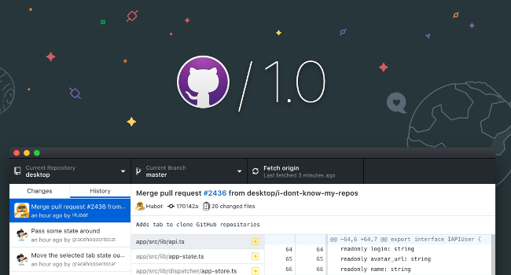
Git & GitHub
web-based, API
host code, data, resources
version control
integrates with open-source and commercial IDE tools
share, collaborate
branching
showcase achievements
command line & desktop versions

Slide 25
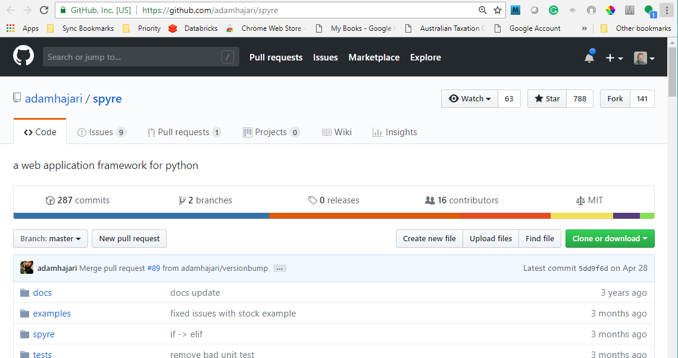
GitHub: Forking & Cloning a Repo
fork: make your own copy of someone else’s repo, on GitHub
click <Fork>
clone: create a (working) copy of the repo on your computer
GitHub Desktop procedure:
click <Clone or download>
click <Open in Desktop>
navigate to target (local) folder
click <Clone>
command-line procedure:
$ cd yourpath
$ git clone https://github.com/ yourgithubname/yourgithubrepo

Slide 26
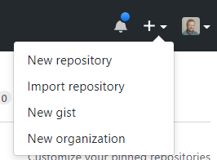
GitHub: Creating a New Repo
from your GitHub home page
<New repository>
clone the repo to your local drive
copy files, folders into it
commit changes
generate a pull request
Creating a branch
to allow development in isolation from source repo
protects your changes from changes to source
rejoin main branch when ready

Slide 27
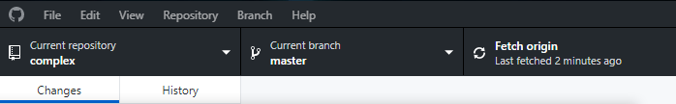
GitHub: Refreshing Local Repo from Source
Desktop
<Fetch origin>
Command-line
$ git checkout master
$ git fetch upstream
$ git merge upstream/master
Ensure you’re in the master branch
Grab the latest changes from the master
Merge the master changes with your repo

Slide 28
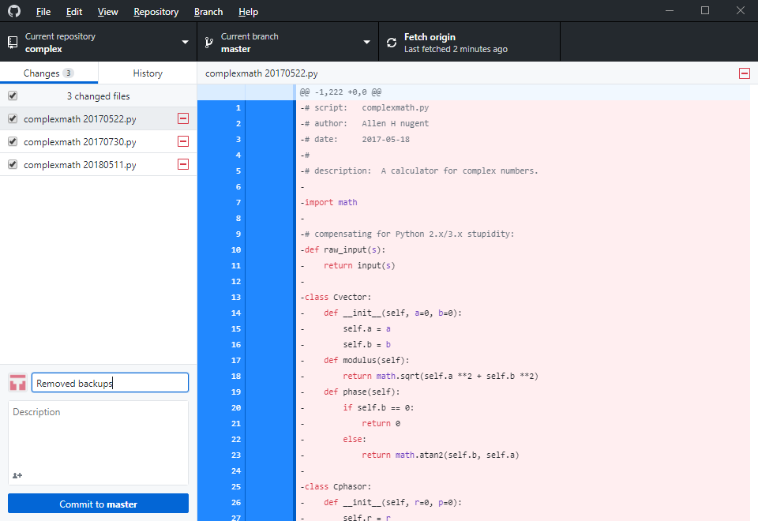
GitHub: Commit & Pull Request
Desktop
enter comments in text box
<Commit to master>
Repository > Push or <Push origin>

Slide 29
GitHub: Commit & Pull Request
Command-line
commit
$ git status
$ git add filename
$ git add .
$ git commit -m your_comments
$ git status
pull request
$ git push origin master
show changes
stage one file
stage all change
commit file(s), with comments
origin = your GitHub repo (forked from source repo)
master = source repo

Slide 30
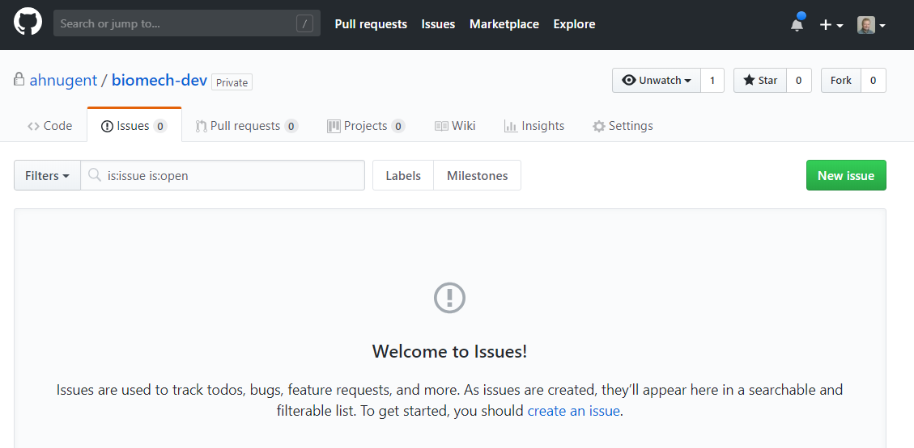
GitHub: Issues
track
issues / bugs
to-do items
feature requests
search
filter

Slide 31
GitHub: Notifications
Triggers
you, a team member, or a parent team are mentioned
you're assigned to an issue or pull request
a comment is added in a conversation you're subscribed to
a commit is made to a pull request you're subscribed to
you open, comment on, or close an issue or pull request
a review is submitted that approves or requests changes to a pull request you're subscribed to
you or a team member are requested to review a pull request
you or a team member are the designated owner of a file affected by a pull request
you create or reply to a team discussion

Slide 32
End of Presentation!

